Slide 1
Overview of Computers
Lecture 1
Based on the text book
Fundamentals of Computer by E.Balagurushamy

Slide 2
Content
What is Computer?
Evolution of Computer
Generation of Computer
Classification of Computer
Parts of Computer System

Slide 3
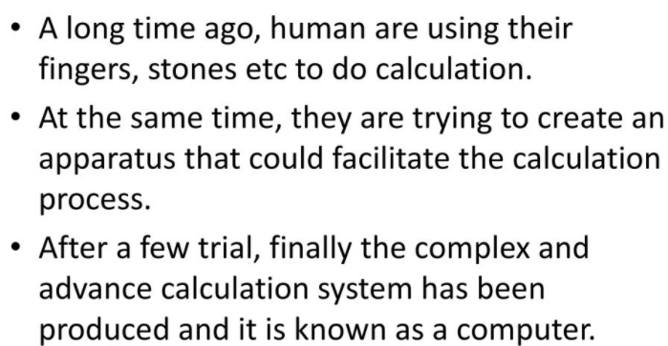

Slide 4
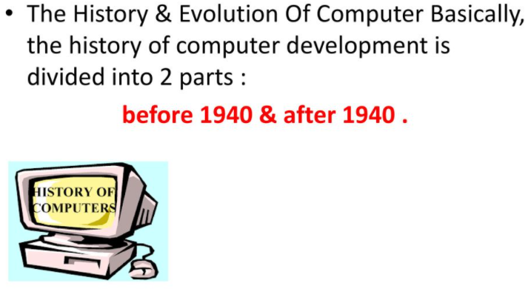

Slide 5


Slide 6
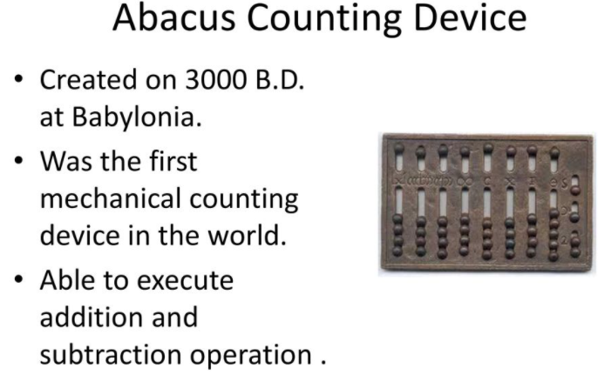

Slide 7
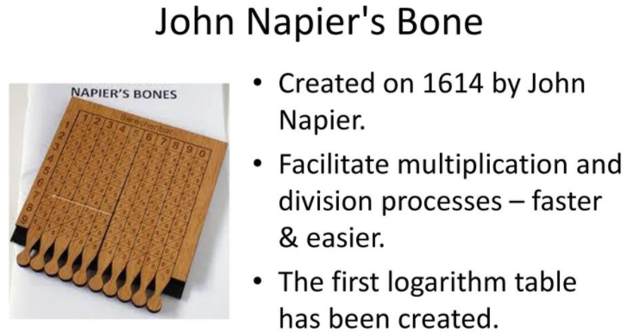

Slide 8
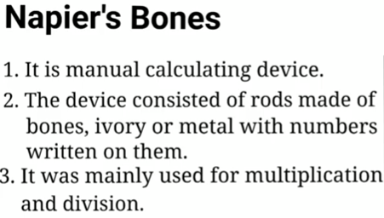
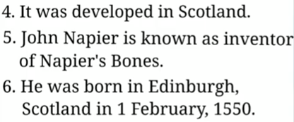

Slide 9
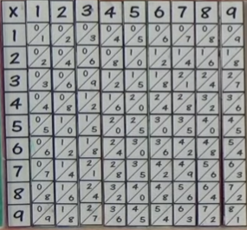
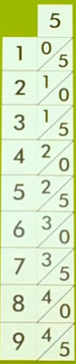

Slide 10
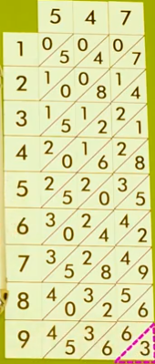
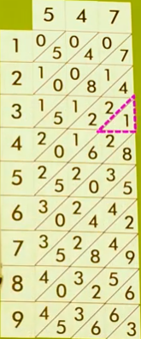
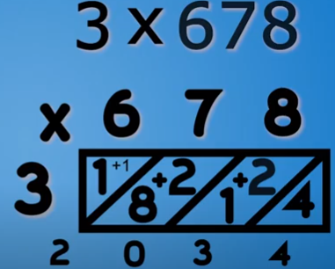

Slide 11
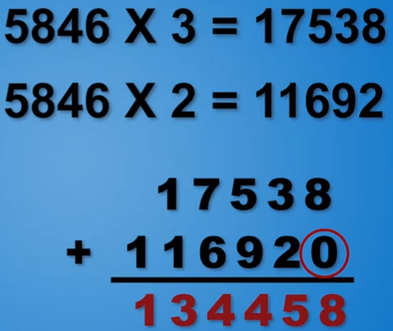

Slide 12
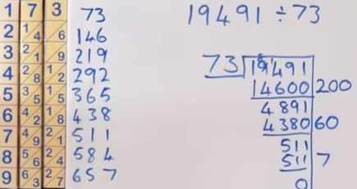
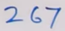

Slide 13
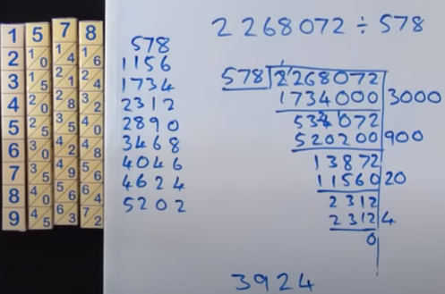

Slide 14
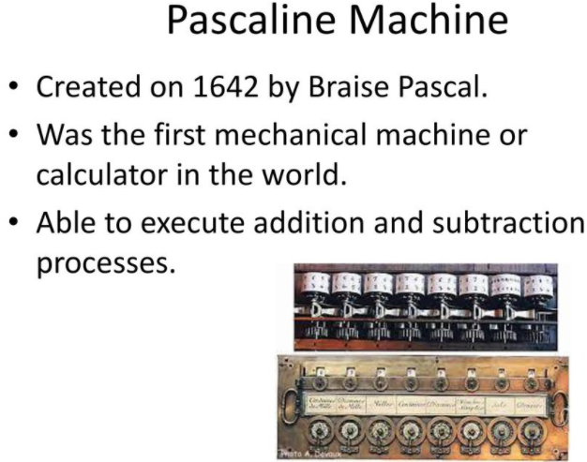

Slide 15
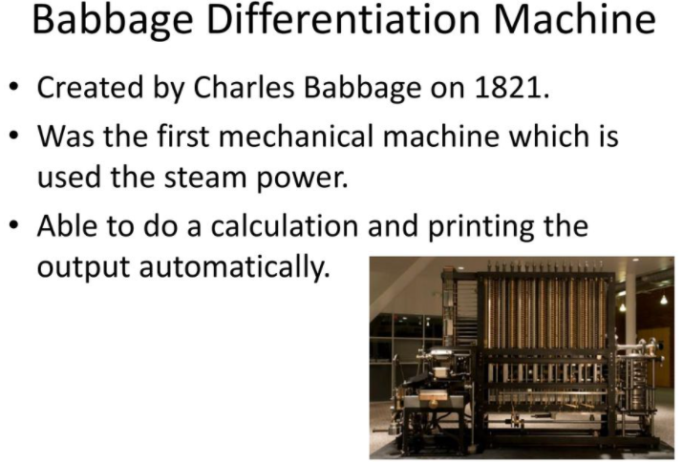

Slide 16
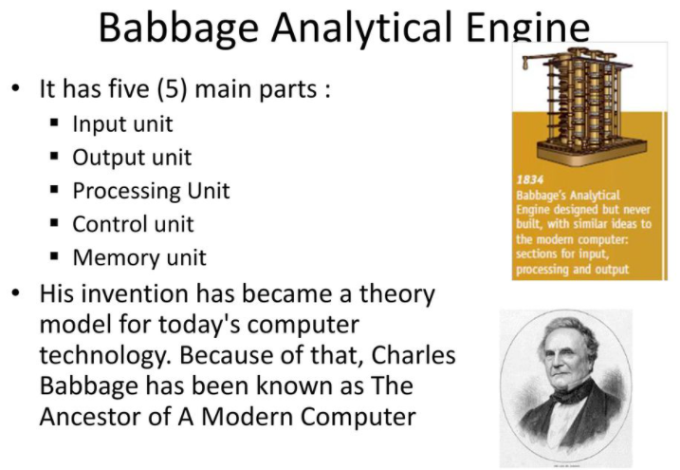

Slide 17


Slide 18
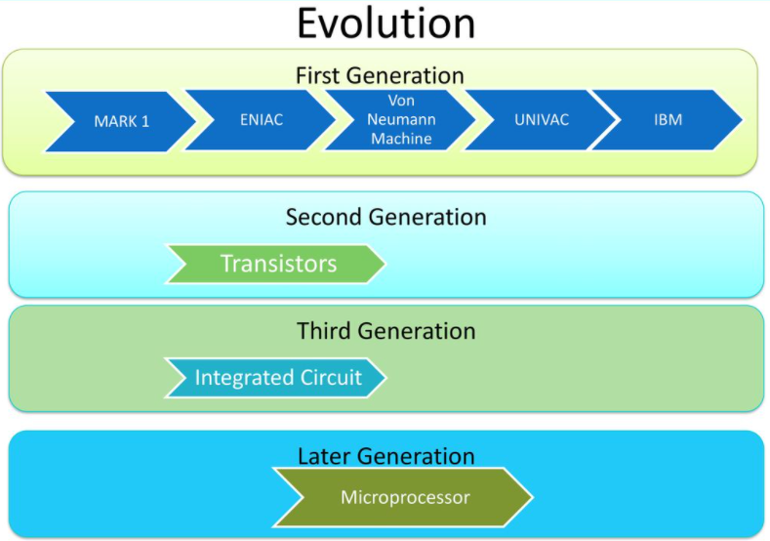

Slide 19
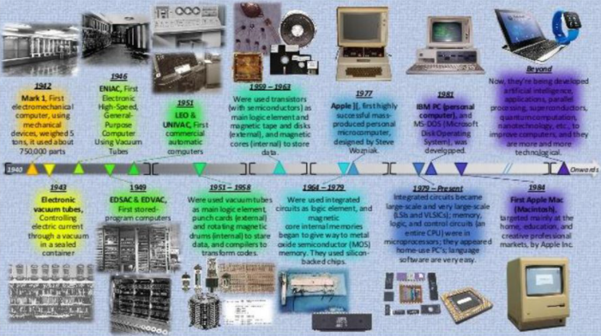

Slide 20
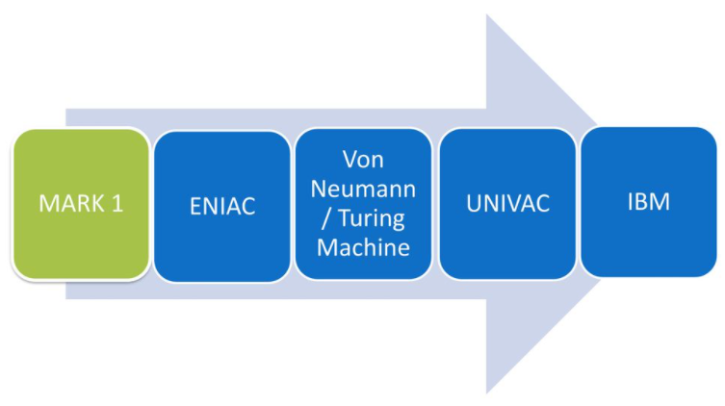

Slide 21
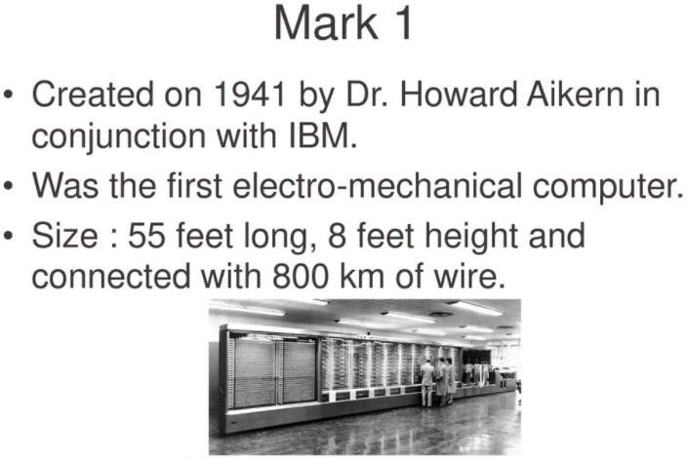

Slide 22
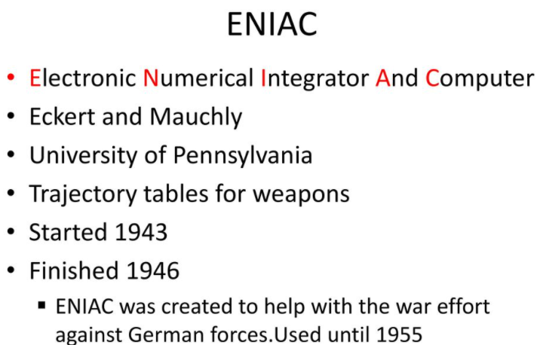

Slide 23
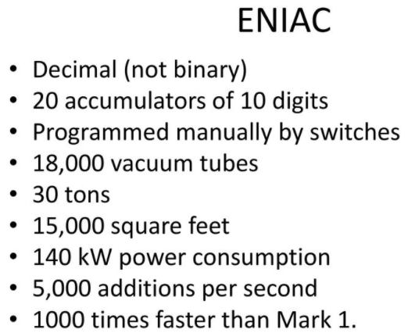
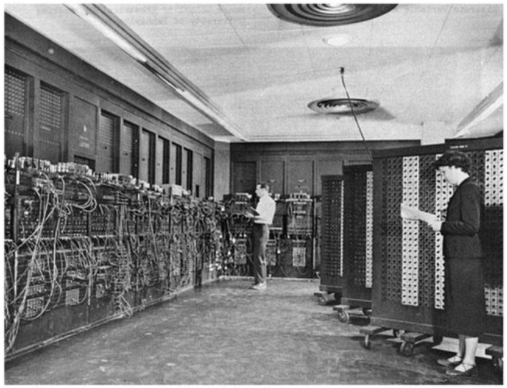

Slide 24
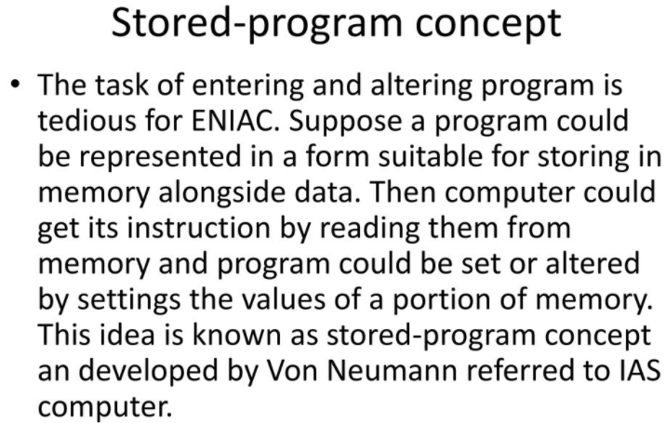

Slide 25
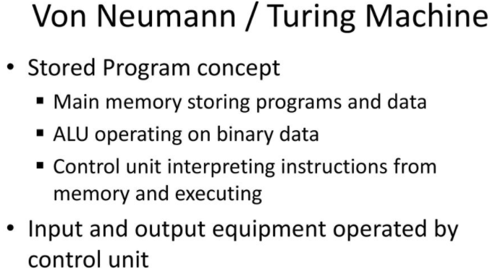
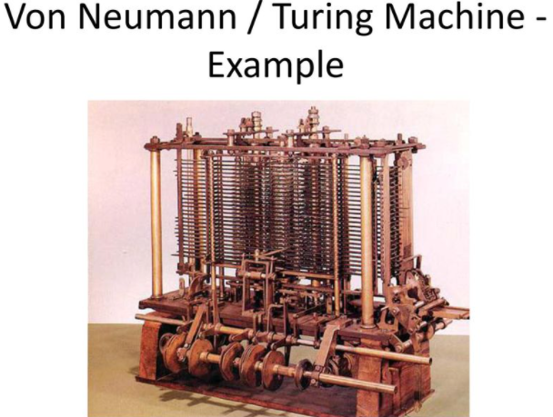

Slide 26
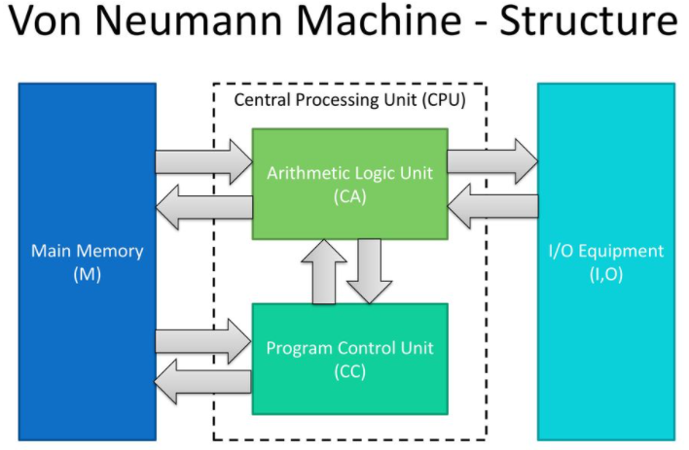

Slide 27
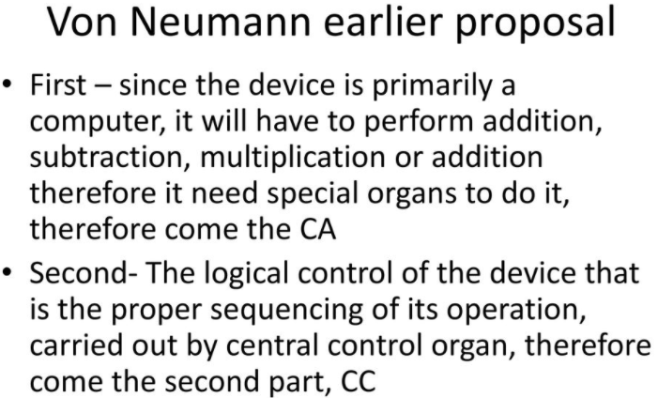

Slide 28
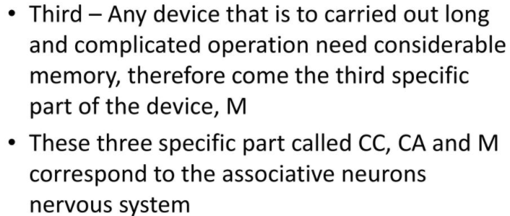
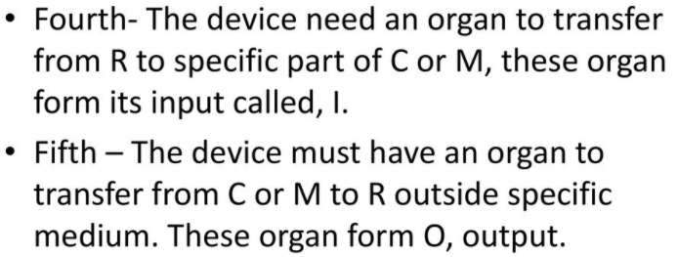

Slide 29
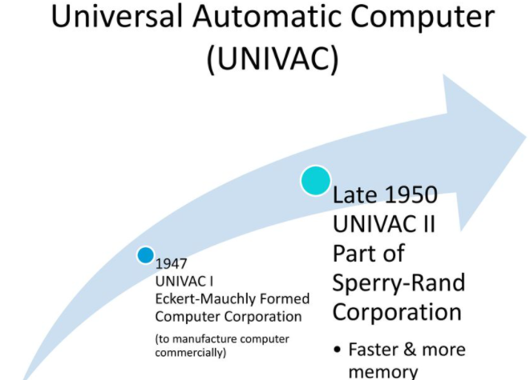

Slide 30
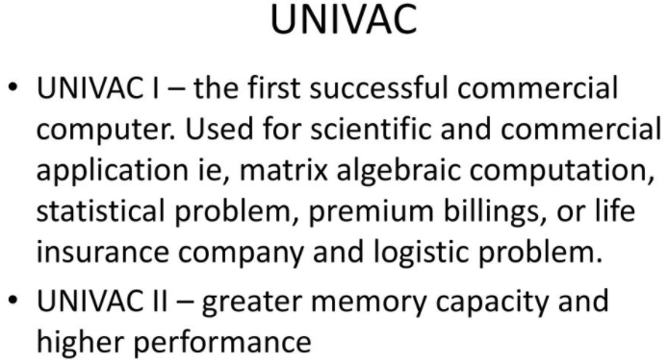
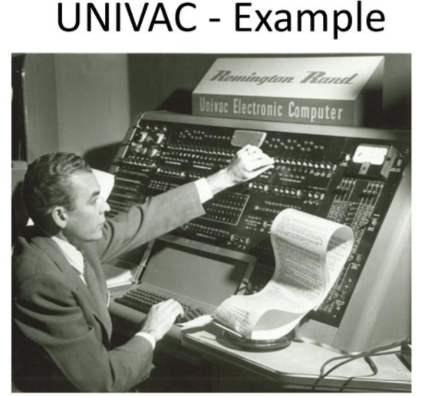

Slide 31
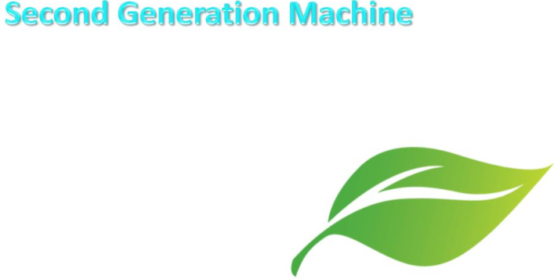

Slide 32
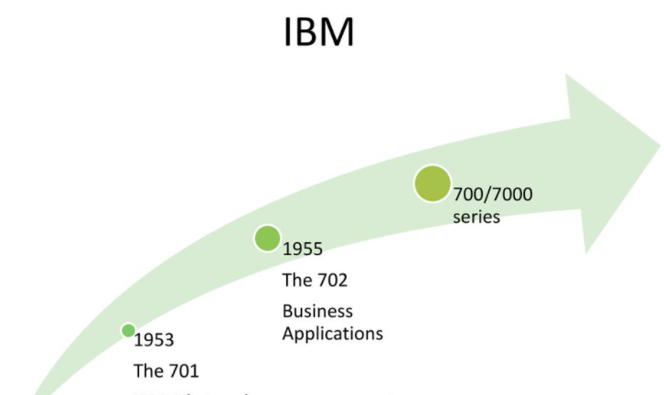

Slide 33
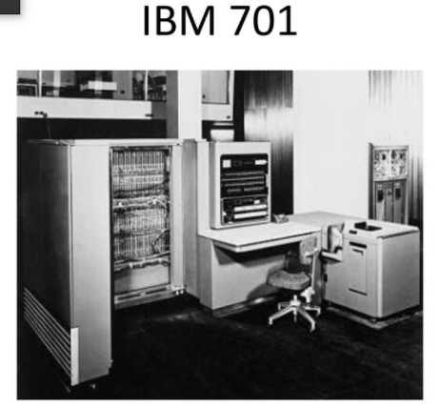
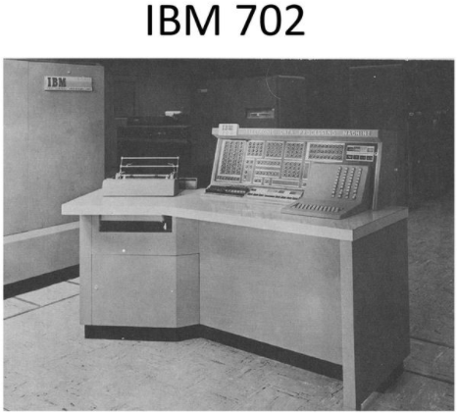
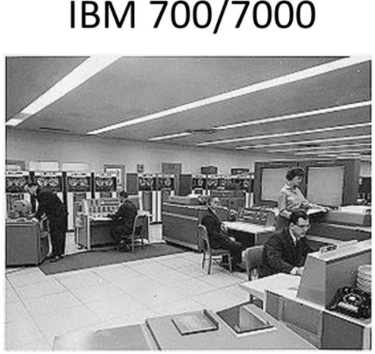

Slide 34
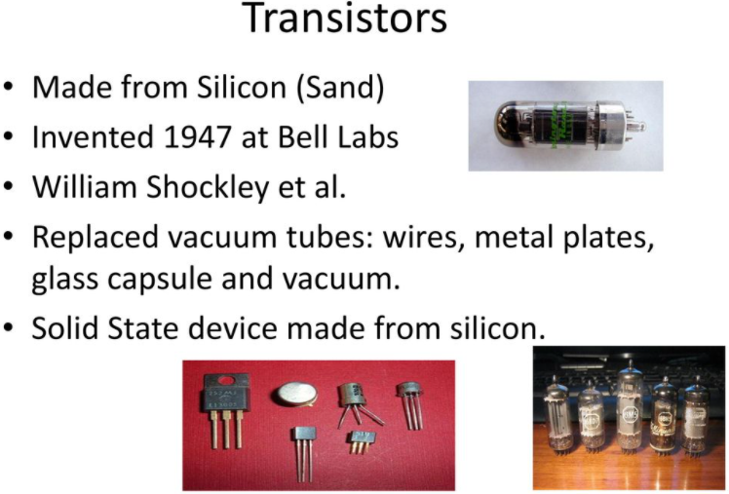

Slide 35
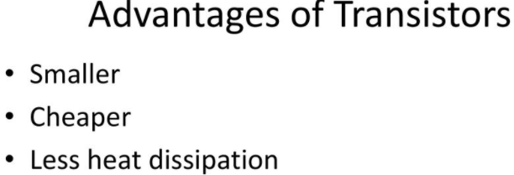

Slide 36
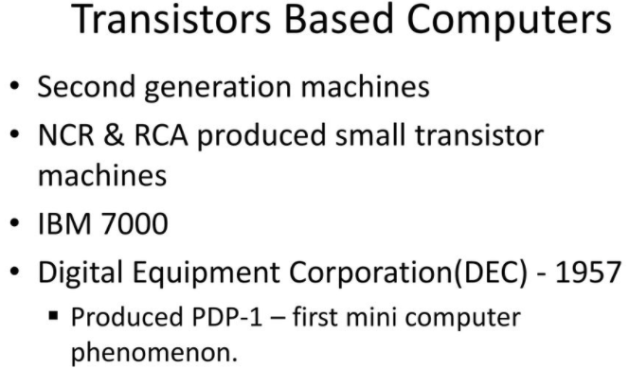

Slide 37
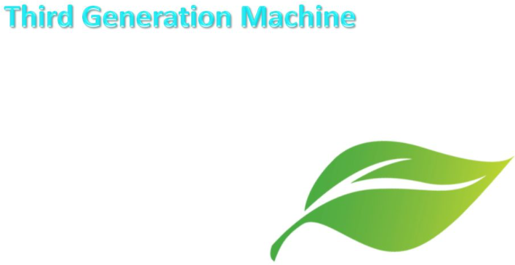

Slide 38
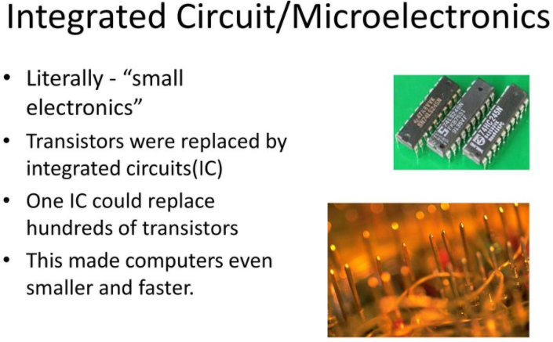

Slide 39
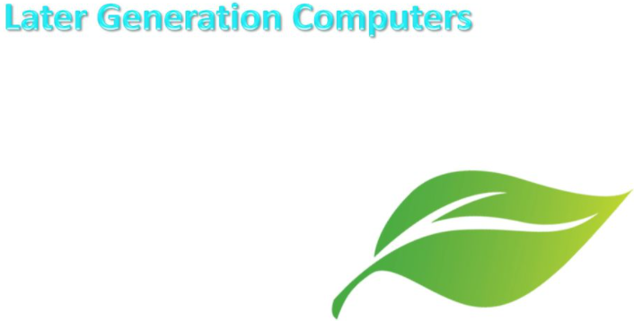

Slide 40
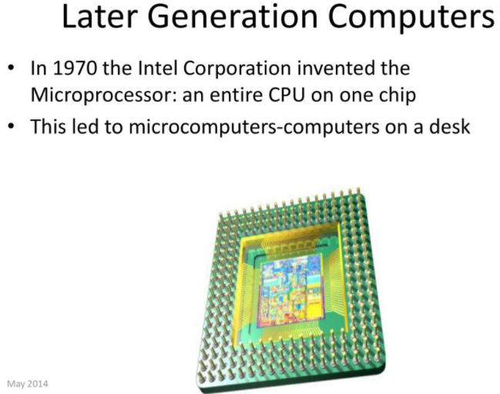

Slide 41
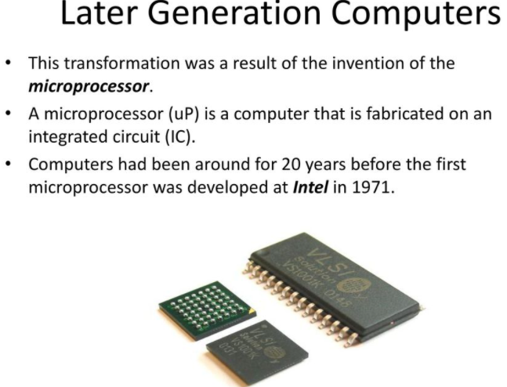

Slide 42
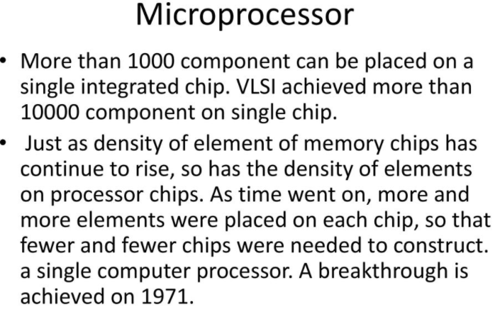

Slide 43
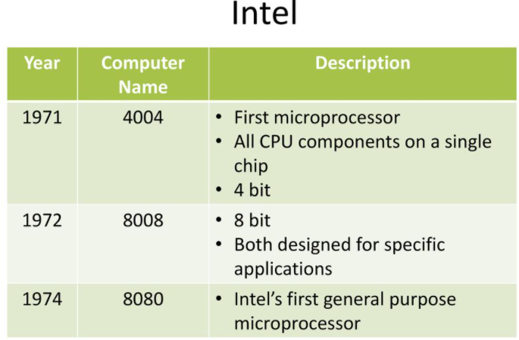

Slide 44


Slide 45


Slide 46



Slide 47


Slide 48



Slide 49
What’s a Computer?
A computer is an electronic machine that takes input from the user, processes the given input and generates output in the form of useful information.
Charles Babbage: A professor of mathematics in the Cambridge University is considered to be the father of modern computer.

Slide 50
Evolution of Computer
Manual Computing Devices
Automated Computing Devices
Manual Computing Devices
Sand table
Abacus
Napier Bones

Slide 51

Evolution of Computer
Abacus:

Slide 52

Evolution of Computer
Napier Bones:

Slide 53
Evolution of Computer
Automated Computing Devices:
Difference engine,
Analytical engine,

Slide 54
Generations of Computers
First Generation Computers:
Employed during the period 1940-1956.
Used the vacuum tubes technology for calculation as well as for storage and control purpose.
Advantages:
(1) Fastest computing devices of their time;
(2) These computers were able to execute complex mathematical problems in an efficient manner.

Slide 55
Generation of Computer
First Generation Computers:
Disadvantages:
(1) The functioning of these computers depended on the machine language.
(2) There were generally designed as special-purpose computers.
(3) The use of vacuum tube technology make these computers very large and bulky.
(4) They were not easily transferable from one place to another due to their huge size and also required to be placed in cool places.
(5) They were single tasking because they could execute only one program at a time.
(6) The generated huge amount of heat and hence were prone to hardware faults.

Slide 56
Generations of Computer
Second Generation Computers:
Employed during the period 1956-1963
Use transistors in place of vacuum tubes in building the basic logic circuits.
Advantages:
(1) Fastest computing devices of their time;
(2) Easy to program because of the use assembly language;
(3) Could be transferred from one place to other very easily because they were small and light;
(4) Require very less power in carrying out their operations;
(5) More reliable, did not require maintenance at regular intervals of time.

Slide 57
Generation of Computer
Second Generation Computers:
Disadvantages:
(1) The functioning of these computers depended on the machine language.
(2) There were generally designed as special-purpose computers.
(3) The use of vacuum tube technology make these computers very large and bulky.
(4) They were not easily transferable from one place to another due to their huge size and also required to be placed in cool places.
(5) They were single tasking because they could execute only one program at a time.
(6) The generated huge amount of heat and hence were prone to hardware faults.

Slide 58
Generation of Computer
Third Generation Computers:
Employed during the period 1964-1975.Use of Integrated Circuits
Advantages:
(1) Fastest computing devices.
(2) Very productive.
(3) Easily transportable from one place to another because of their small size.
(4) Use high-level languages.
(5) Could be installed very easily and required less space.
(6) Can execute any type of application.
(7) More reliable and require less frequent maintenance schedules.

Slide 59
Generation of Computer
Disadvantages:
(1)The storage capacity of these computers was still very small.
(2) The performance of these computers degraded while executing large applications, involving complex computations because of the small storage capacity.
(3) The cost of these computers was very high.
(4) They were still required to be placed in air-conditioned places.

Slide 60
Generation of Computer
Fourth Generation Computers:
Employed during 1975-1989 and Use of Large Scale Integration technology(LSI) and Very Large Scale Integration technology(VLSI).
The term Personal Computer (PC) became known to the people during this era.
Advantages:
(1) Very powerful in terms of their processing speed and access time.
(2) Storage capacity was very large and faster.
(3) Highly reliable and required very less maintenance.

Slide 61
Generation of Computer
Fourth Generation Computers:
Advantages:
(4) User-friendly environment;
(5) Programs written on these computers were highly portable;
(6) Versatile and suitable for every type of applications;
(7) Require very less power to operate.
Disadvantages:
(1) The soldering of LSI and VLSI chips on the wiring board was not an easy task and required complicated technologies to bind these chips on the wiring board.
(2) The working of these computers is still dependent on the instructions given by the programmer.

Slide 62
Generation of Computer
Fifth Generation Computers:
The different types of modern digital computers come under this category. Use Ultra Large Scale Integration technology(ULSI) that allows almost ten million electronic components to be fabricated on one small chip.
Advantages:
(1) Fastest and powerful computers till date.
(2) Being able to execute a large number of applications at the same time and that too at a very high speed.

Slide 63
Generation of Computer
Fifth Generation Computers:
Advantages:
(3) Decreasing the size of these computers to a large extent.
(4)The users of these computers find it very comfortable to use them because of the several additional multimedia features.
(5) They are versatile for communications and resource sharing.

Slide 64
Classification of Computer
We can classify the computers according to the following three criteria:
Based on operating principles
(2) Based on applications
(3) Based on size and capability

Slide 65
Classification of Computer
Based on operating principles:
Analog computers: represent data in the form of continuous electrical signals having a specific magnitude
Digital computers: store and process data in the digital form.
Hybrid computers: a combination of analog computer and digital computer because it encompasses the best features of both.

Slide 66
Classification of Computer
Based on applications:
General purpose computers: can work in all environments.
Special purpose computers: can perform only a specified task.

Slide 67
Classification of Computer
Based on size and capability:
Microcomputers: Designed to be used by individuals.
Mini Computers: Can handle more data and more input and output than micro computers.
Mainframe Computers: A very large computer.
Super Computers: The fastest type of computer that can perform complex operations at a very high speed.

Slide 68
Data and Information
Data consists of individual facts that are not organized in a meaningful way.
Information is the processed raw data.

Slide 69
Bit and Byte
Bit is a single unit of binary data representation.
One byte is a string of 8 bits. One byte is used to represent a character.
1 Byte = 8 bits

Slide 70
Parts of a Computer System
A complete computer system is consists of following parts-
Hardware
Software
Data
Users
The mechanical devices that make up the computer system is called hardware.
Software is a set of instructions that are computer uses to perform different tasks.
Individual facts or piece of information.
Computer operators.

Slide 71
Hardwares
Processor
Memory
I/O
Storage
Motherboard, Processors, CPU
Processing devices
RAM, ROM
Memory Devices
Keyboard, Monitor, Mouse, Printer, Scanner
I/O devices
Hard disk (magnetic), CD-ROM (Optical), CD-R (Optical)
Storage devices

Slide 72
Softwares
Application
System
Different computer applications, like MS office, Media players
Different OS software's. Like, Windows, Linux, Different system utilities etc.

Slide 73
Thank You!

